Slide 1
Software testing course presentations
Phan Tai Duc Pham Tuan Anh Huu Thang Duc Thang

Slide 2
The presentation consists of 2 parts
Test levels
Test types

Slide 3
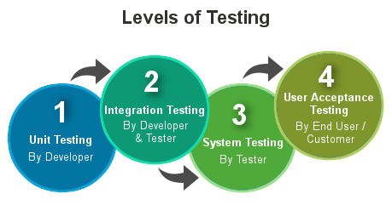
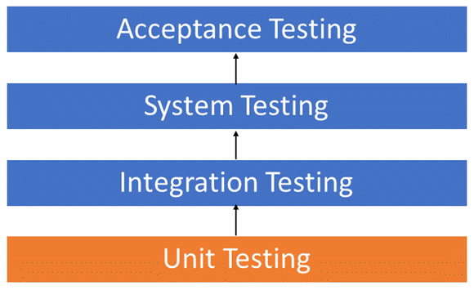
Test levels

Slide 4
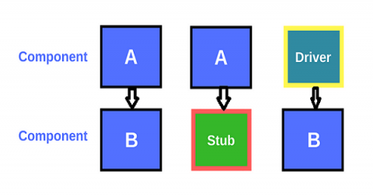
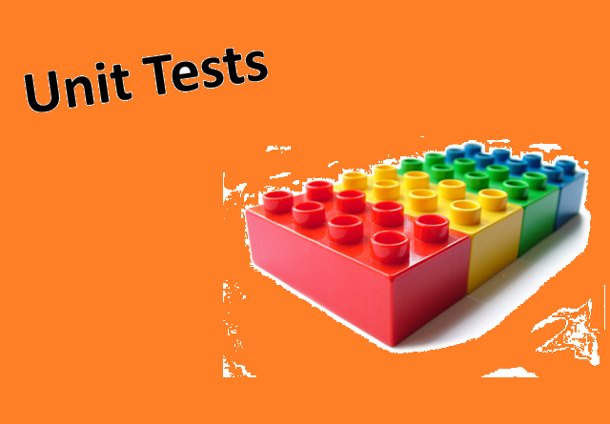
Unit testing (Kiểm thử đơn vị)
Component testing, also known as unit, module and program testing, searches for defects in, and verifies the functioning of software (e.g. modules, programs, objects, classes, etc.) that are separately testable
Developer is responsible for the unit test

Slide 5
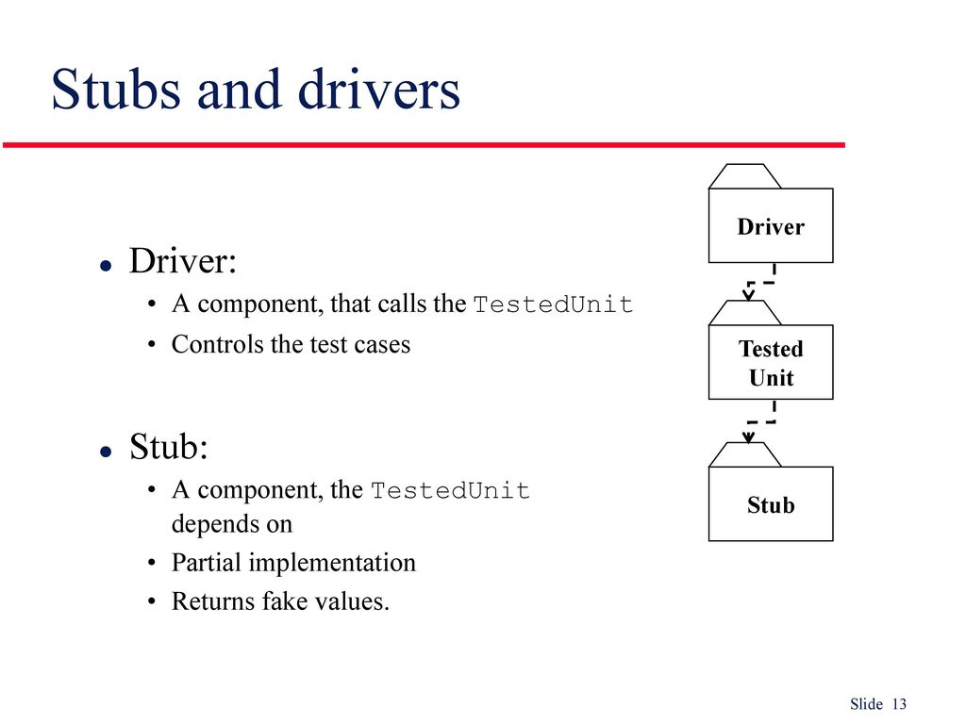
Unit testing (Kiểm thử đơn vị)
Devices: Stub, driver
What is Driver and Stub in software testing?
-Stubs are called Functions in Top Down Integration.
-Drivers are calling Functions in Bottom Up Integration.

Slide 6


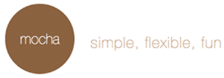
Unit testing (Kiểm thử đơn vị)
Some libraries are used for unit testing:
- Junit (java)
- PHPunit (php)
- Mocha (javascript)
- …

Slide 7
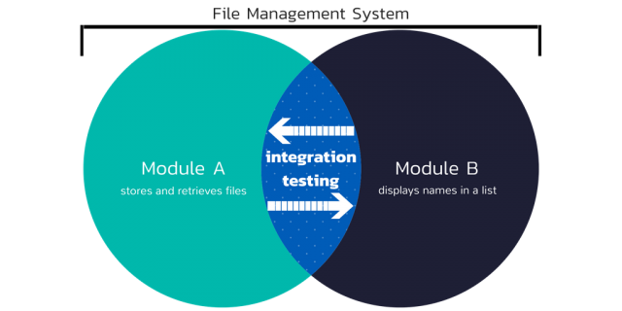
Integration testing (Kiểm thử tích hợp)
Integration testing tests interfaces between components, interactions with different parts of a system.

Slide 8
Integration testing (Kiểm thử tích hợp)
Approach:
Big-Bang
Top-down method
Bottom-up method
Functional incremental

Slide 9
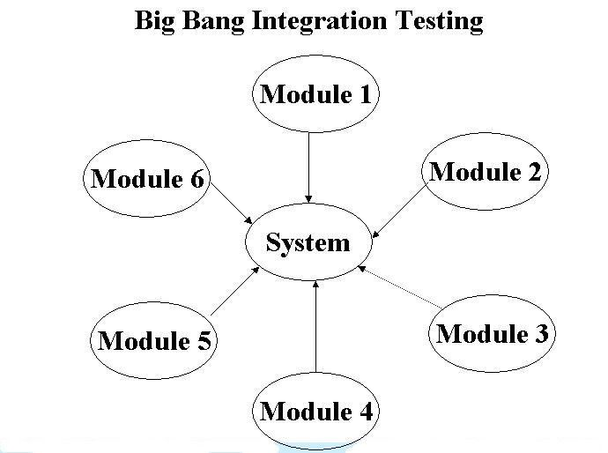
Integration testing (Kiểm thử tích hợp)
Big-Bang
This is an integrated test method where all or most units are combined and tested together. This method is performed when the test team receives the entire software.

Slide 10
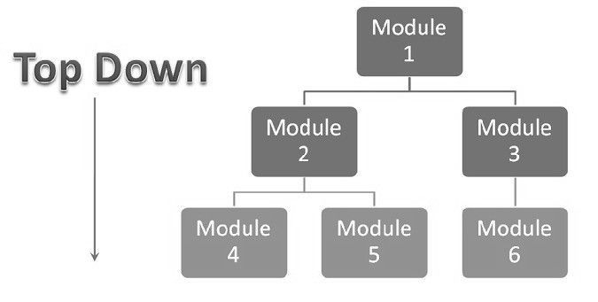
Integration testing (Kiểm thử tích hợp)
Top-down method
Testing is performed from top to bottom. The highest unit is tested first, the lower unit is tested then in a singly way.

Slide 11
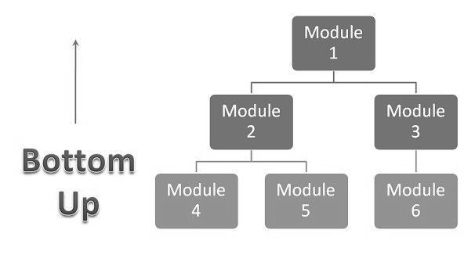
Integration testing (Kiểm thử tích hợp)
Bottom-up method
Testing is performed from bottom to top. The lowest unit is tested first, the higher unit is tested later.

Slide 12
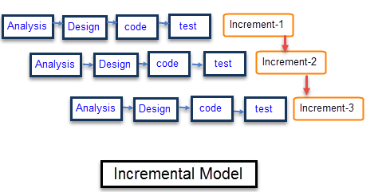
Integration testing (Kiểm thử tích hợp)
Functional incremental
Integration and testing takes place on the basis of the functions and functionalities, as documented in the functional specification.

Slide 13
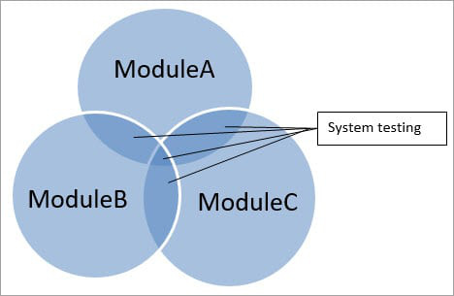
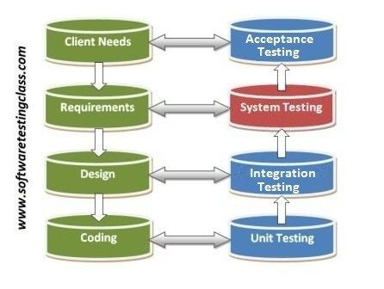
System testing (Kiểm thử hệ thống)
System testing is to test a fully integrated system to ensure it works as required.
System testing is a black box test and is focused on the functionality of the system. Check the functions and interface, the behavior of the system in a complete way that meets the requirements.
The purpose of this stage is to assess whether the operation of the system is in accordance with the specification document and carried out by the testers.

Slide 14
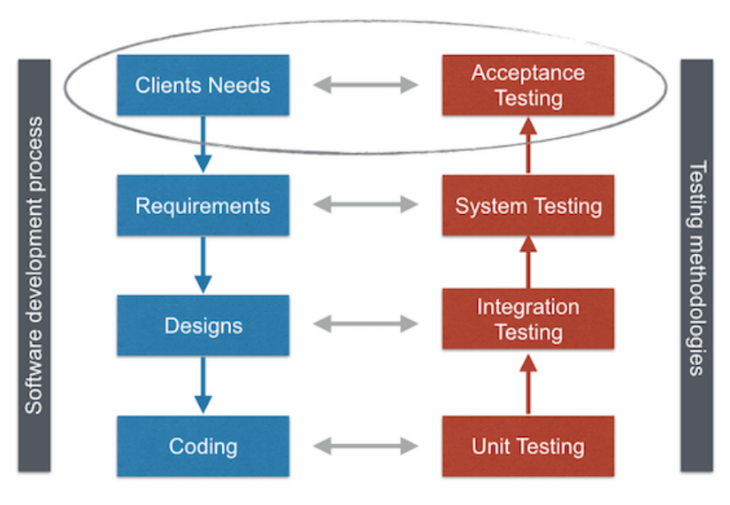

Acceptance Testing (Kiểm thử chấp nhận)
Formal testing with respect to user needs, requirements and business.
Acceptance testing is most often the responsibility of the user or customer
The goal of acceptance testing is to establish confidence in the system, part of the system or specific non-functional characteristics, e.g. usability, of the system.
Finding defects should not be the main focus in acceptance testing.

Slide 15
Acceptance Testing (Kiểm thử chấp nhận)
Some acceptance testing types:
User acceptance testing
Operational (acceptance) testing
Testing of backup/restore;
Disaster recovery;
User management;
Maintenance tasks;
Periodic checks of security vulnerabilities.
Contract and regulation acceptance testing
Alpha and beta (or field) testing

Slide 16
Test types
Test types
Functional Testing
Non-Functional Testing
Structural Testing
Testing related to changes

Slide 17

Functional Testing (Kiểm thử chức năng)
Functionality testing can be done on:
Requirements-based testing
Business-process-based testing
Additional functional testing:
Suitability
Interoperability
Security
Accuracy and compliance

Slide 18
01
Functional Testing
Requirements-based
02
Functional Testing
Business-process-based

Slide 19

Requirement-based
Use system requirements specifications as the basis for the design test. A good way to start is to use the requirements specification table of contents as a list of test and non-test items . This will ensure the most important parts will be tested.

Slide 20
Business-process-based
Use the knowledge of business processes. Business processes describes the scenarios related to the daily business of the system

Slide 21
Software testing course presentations
Phan Tai Duc Pham Tuan Anh Huu Thang Duc Thang

Slide 22







Slide 23

Determine the functions the software wants to perform

Slide 24

Generate input data based on the specification documents of the functions

Slide 25

Determine the output based on the document’s specification of the function

Slide 26

Performing test cases

Slide 27

Compare actual results with desired results

Slide 28
Types of functional testing
Unit testing
Integration Testing (kiểm thử tích hợp)
Smoke testing
System Testing
Sanity Testing (kiểm thử tỉnh táo)
Interface Testing
Acceptance Testing

Slide 29
Non-functional Testing
Non-Functional Testing is testing an application's properties that are not related to any particular functionality or user behavior such as performance, compatibility, security or the behavior of the application according to constraints. certain
Non-functional testing is like functional testing which is perfomed at all testing levels.

Slide 30




Slide 31








Load testing
02
01
Performance testing
03
Stress testing
07
04
Portability testing
05
06
Usability testing
Maintainability testing
Reliability testing

Slide 32
Characteristics
Functionality
Reliability
Characteristics and sub characteristics
Usability
Efficiency
Maintainability
Portability

Slide 33

Structural Testing (Kiểm thử kết cấu)
What Is Structural Testing : Structural testing is the type of testing carried out to test the structure of code. It is also known as White Box testing or Glass Box testing.

Slide 34
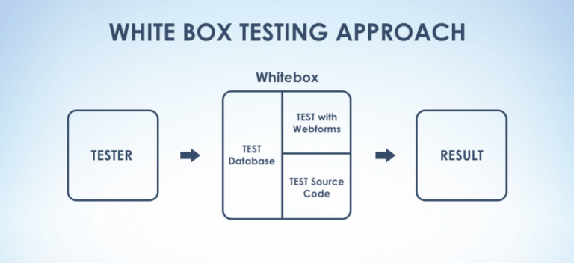
Structural Testing (Kiểm thử kết cấu)
White Box Testing is software testing technique in which internal structure, design and coding of software are tested to verify flow of input-output and to improve design, usability and security. In white box testing, code is visible to testers so it is also called Clear box testing, Open box testing, Transparent box testing, Code-based testing and Glass box testing.

Slide 35
Advantages
It provides thorough testing of the code and finally the software
All the early defects can easily be identified
It eliminates the dead code or statements
The steps of structural can be automated if you have time
Translational errors while typing, unwanted Risks with the data and other technical standards can easily be validated with this testing

Slide 36
Disadvantages
Below are the disadvantages:
There are few shortcomings in each technique as discussed in each coverage even though there are alternates
Heavy dependency on the skill set of the tester as thee code component is tested
Since this is more detailed testing, it is quite

Slide 37
Testing related to changes (Kiểm tra liên quan đến các thay đổi)
Confirmation testing (Kiểm thử xác nhận)
Regression Testing(Kiểm thử hồi quy)

Slide 38
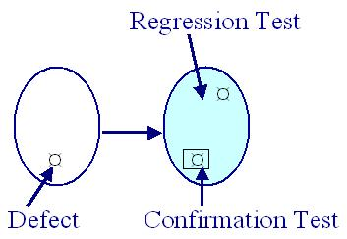
Confirmation testing (re-testing)
Needed when there is a defect fixed or change requirement
Test to confirm defect has indeed fixed or new change is correct

Slide 39
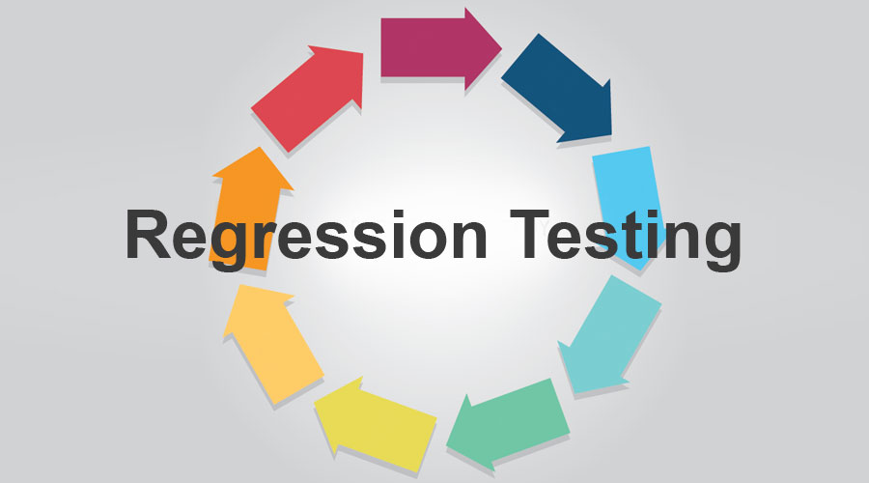
Regression Testing
Execute test cases that are executed before
Test to ensure there is no defect is made due to change of source code
There should be a regression test suite that executed every time a new version of source code produced

